Slide 1
Computer Hardware

Slide 2
The computer system
A computer system comprises of the:
hardware,
software,
data/information,
people and
procedures.
Roles played by people in the computer system.
People are designers
People are manufacturers
People use computer systems

Slide 3
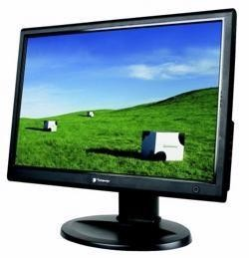

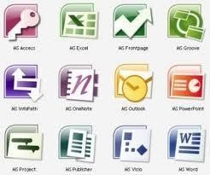
The computer system
.
Hardware
User
software

Slide 4
Computer Hardware
Computer hardware are the tangible components of a computer system. For example keyboard, monitor, modem, mouse, printer etc.
They maybe peripheral devices or accessories devices.
Accessories devices support the proper handling of the computer. For example, a computer bag or a computer stand.

Slide 5
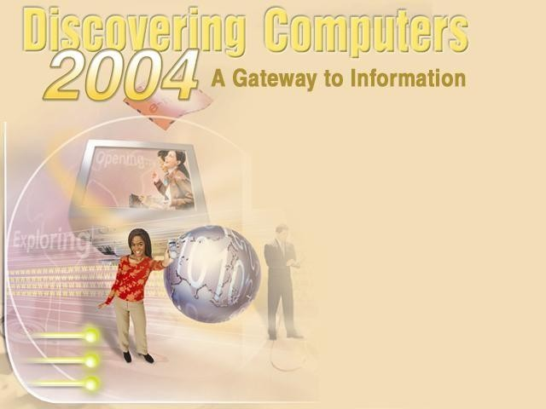
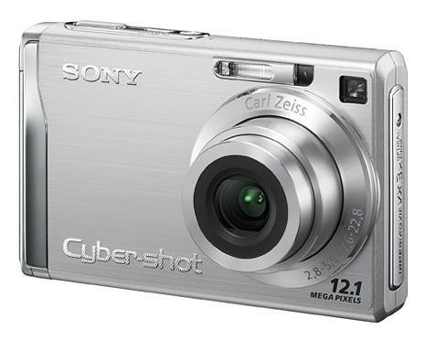
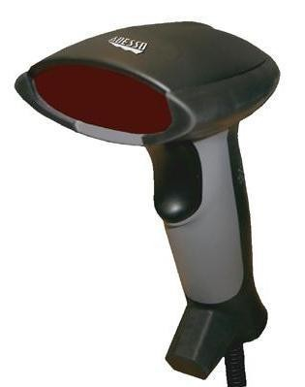
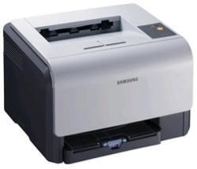
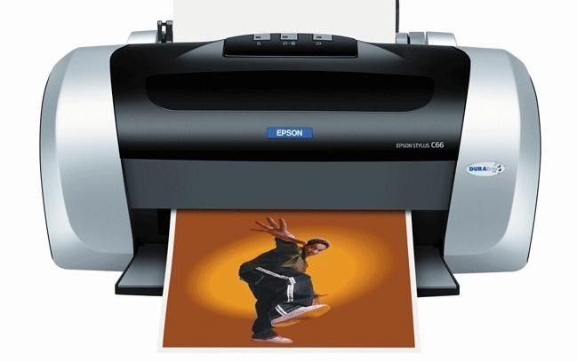
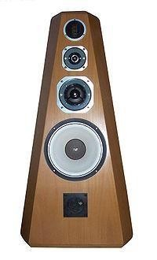
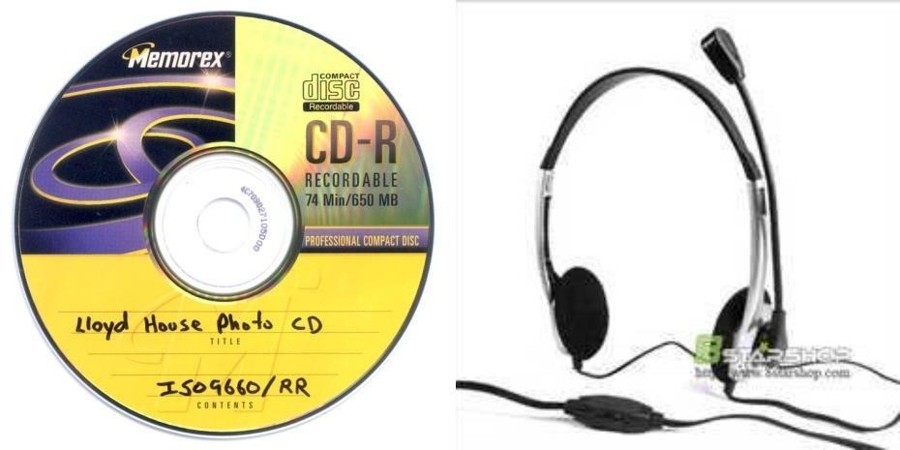
Computer Hardware
1/4/2016
CNAMS-2015/2016
3
7

Slide 6
Categories of computer hardware
Computer hardware can be categorized into;
Input devices
Processing devices
Output devices
Storage devices
Communication devices

Slide 7
Input devices
These are devices used to enter data into the computer system.
Examples of input devices include;
Keyboard
Mouse
Scanner
Webcam
Microphone
Joystick
Light pen
Camera

Slide 8
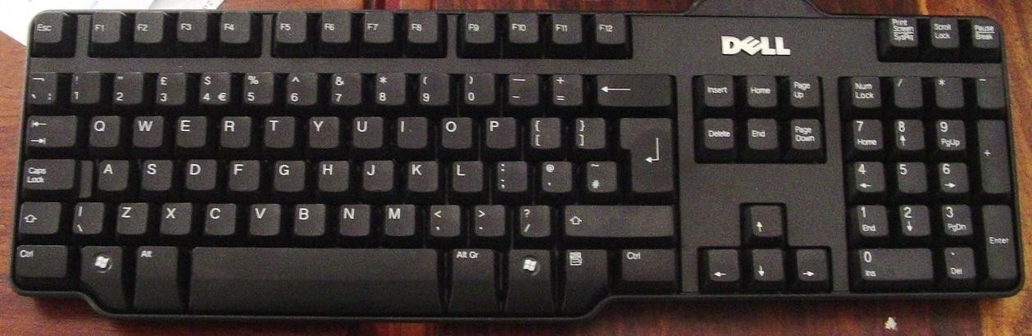
keyboard
It is used for entering text or symbols like letters and numbers into the computer. It is the main input device for most computers.

Slide 9
Main keys on the keyboard
Typing keys – These keys include the letter keys (A-Z) and digits keys (0-9) which generally give same layout as that of typewriters.
Numeric keys – It is used to enter numeric data or cursor movement. Generally, it consists of a set of 17 keys that are laid out in the same configuration used by most adding machines and calculators.
Function keys – The twelve functions keys are present on the keyboard. These are arranged in a row along the top of the keyboard. Each function key has a unique meaning and is used for some specific purpose.
Control keys – These keys provide cursor and screen control. It includes four directional arrow key. Control keys also include Home, Insert, Delete, Page Up, Page Down, Control(Ctrl), Alternate(Alt), Escape(Esc).
Special purpose keys – Keyboard also contains some special purpose keys such as Enter, Shift, Caps Lock, Num Lock, Space bar, Tab and Print Screen.

Slide 10
Short Explanation of keyboard keys (Button)
ENTER or RETURN - Moves the cursor down one line and to the left margin.
DEL or DELETE - Deletes the character at cursor and/or characters to the right of the cursor and all highlighted (or selected) text.
BKSP or BACKSPACE – Deletes the character to the left of the cursor and all highlighted text.
SPACE BAR – Moves the cursor one spaces at a time to the right.
SHIFT KEY – Use the shift keys to type capital letters and to type the upper character on keys with two characters on them.
CAPS LOCK – Locks the keyboard so it types capital letters.
TAB – Moves the cursor five spaces to the right
ESC or ESCAPE – Cancels a menu or dialogue box.
ARROW KEYS – Moves the cursor around document without changing text.
FUNCTION KEYS or F KEYS – Access commands by themselves or in combination with the three command keys; CTRL, SHIFT and ALT.

Slide 11
The Mouse
The mouse is the pointing device which is used to select different objects. It has two buttons (left and right) that control the movement of the cursor.
Left button – It is used to select menu options or commands by pointing and pressing the button once.
Right button – It is used to access shortcut menu within windows application.
Scroll wheel - It is used to show the hidden part of the document in different applications. For example in MS Word, MS Excel

Slide 12
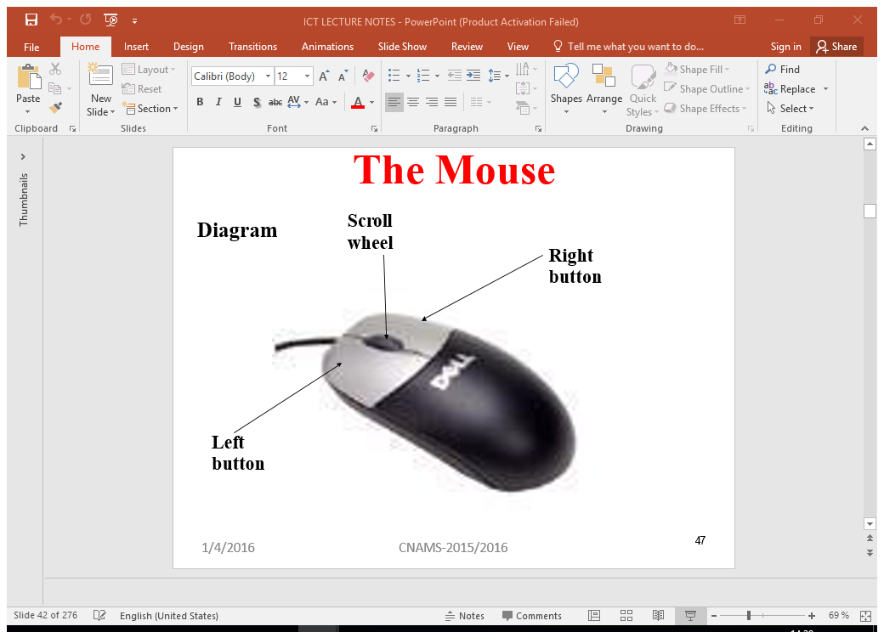
The Mouse

Slide 13
Using the Mouse
Left click: Use your first finger to click the left once.
Right click :Use your second finger to click the right button once
Double click :Use your first finger to click the left mouse button twice quickly
Drag :Click and hold the left mouse button, move the mouse as necessary then release the left mouse button
Scroll wheel :Helps to move up and down a document in some applications

Slide 14
Mouse actions operations
Point: To point an item means to move the mouse pointer so that it's touching the item.
Click: Point to the item, then tap (press and release) the left mouse button.
Double-click: Point to the item, and tap the left mouse button twice in rapid succession - click-click as fast as you can.
Right-click: Point to the item, then tap the mouse button on the right.
Drag : Point to an item, then hold down the left mouse button as you move the mouse. To drop the item, release the left mouse button.

Slide 15
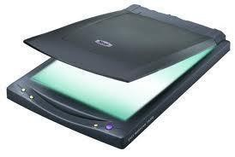
Scanners
✓ Scanners: Allow user to copy or transfer photos, pictures, even some objects to a file on your computer.
It transfers the information to the computer as a bitmap.
✓ It will also allow you to scan a page of text using the OCR (Optical Character Recognition) software to be able to later edit that text in your word processor.

Slide 16
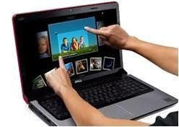
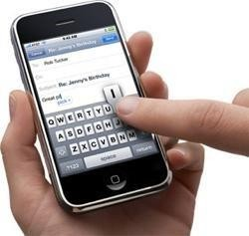
Touch Screen
This is a special kind of screen which is sensitive to touch. Touching with their finger the desired icon or menu item displayed on the screen.

Slide 17
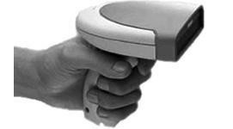
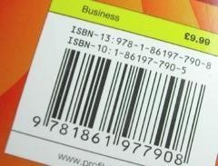
Bar Code Reader (BCR)
A barcode is simply a numeric code represented as a series of lines. These lines can be read by a barcode reader/scanner, convert the data into electrical signal and send them to computer for processing.

Slide 18
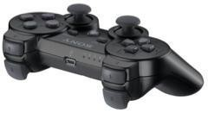
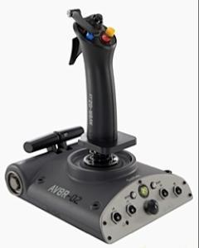
Joysticks
A joystick is mainly used for playing games. Small joysticks can also be found on some mobile phones.

Slide 19
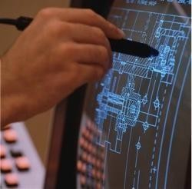
Light Pen
A light pen is a device used as a pointing device to write on the screen of a computer.

Slide 20
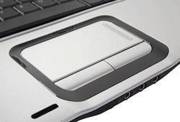
Touchpad / Trackpad
A pointing device found on most laptops

Slide 21
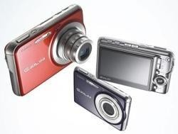
Digital Camera

Slide 22
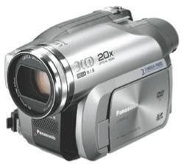
Video Camera
Most video cameras do not directly input data into a computer, the captured movies are stored on video-tape or memory cards and later transferred to a computer.

Slide 23
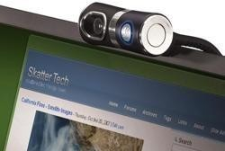
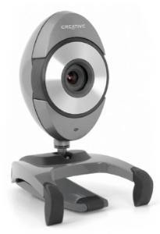
Web Cam
This is a camera used to feed live video into a computer.
This kind of video is of low quality compared to a full video camera.

Slide 24
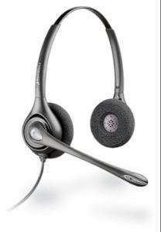
Microphone
A microphone converts sound into a signal that can be fed into a computer.

Slide 25
Processing devices.
Processing devices are devices used to convert raw data information.
The device responsible for processing activities in a computer is the Central Processing System.
Processing data may include the following:
Calculating
Sorting
Searching
Storing
Drawing

Slide 26
Processing Devices
These are devices used to process or convert raw data into information. In computer system this device is known as Central Processing Unit (CPU)
CPU: Is a main component of the computer, used process the data fed into the computer to get information that is understood by human.

Slide 27
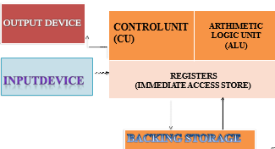
Parts of the CPU

Slide 28
Components of the CPU
Coordinating the input and output devices.
It directs the flow of data from the CPU and input and output devices.
Tell the rest of the computer system how to carry out a program execution.
It directs the movements of electronic signals between main memory and logic units.
It directs electronic signals between main memory and the input/output devices.

Slide 29
Arithmetic Logic Unit
It performs arithmetic operations of addition, subtraction, division and multiplication.
It performs all logical operations of comparison. For example, <,>,=

Slide 30
Registers
Registers store data and instructions that are currently being used by the CPU. This increases the processing speed of the computer system.

Slide 31
The CPU speed
The CPU speed is measured in HERTZ (Hz) i.e. number of operations that can be done per second.
We may have KHz, MHz and GHz.

Slide 32
Functions of the CPU
It carries out all the processing operations of the computer system.
It controls the sequence of operations.
It gives commands to all the parts of the computer system, like the keyboard, mouse, printer etc.
It communicates with the input devices, output devices and storage devices.

Slide 33
Output devices
These are devices that translate information processed by the computer into a form that humans can understand.
These devices enable the user of the computer to get the result of the processed data.
They display processed data.

Slide 34
Examples of output devices.
Monitor
Printer
Speakers
Projectors etc.

Slide 35
Categories of output
Softcopy:-Is the data that is shown on a display screen or is in audio or voice e g:-Monitor, Speakers. Soft copy is an intangible piece of information.
Hardcopy:- Is the printed output e g by a printer. A printed paper is a good example of Hard copy output.

Slide 36
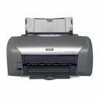
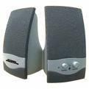
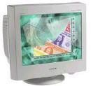
Output devices.
.

Slide 37
Monitor
This is the display device for a personal computer. It displays results in form of text, graphs, images, videos etc.

Slide 38
Types of monitors
There are two types of monitors:
Cathode Ray Tube monitor (CRT)
Flat Panel/ Liquid Crystal Display (LCD) monitor.

Slide 39
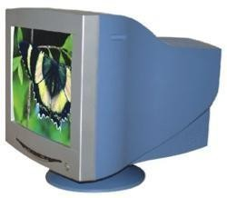
CRT Monitors
Is Just like a television set.
CRT monitors are heavy and use more electrical power than flat panel displays, but they are preferred by some graphic artists for their accurate color rendition, and preferred by some gamers for faster response to rapidly changing graphics.

Slide 40
LCD Monitors
Flat-screen monitors are light in weight and they take up very little desk space.
They have little energy consumption and have liquid that reduces the intensity of contacted rays.
Monitor screen size is measured diagonally across the screen in inches.

Slide 41
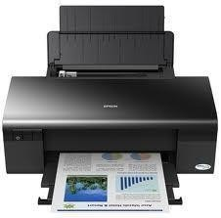
Printer
This is the output device which produces the hardcopy (printed) output.

Slide 42
Types of printers
Dot matrix printers
Ink jet printers
Laser printers.

Slide 43
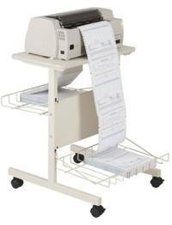
Dot matrix printers
The quality is poor
The printer is noisy

Slide 44
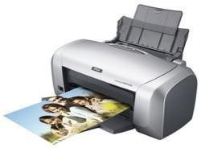
Ink jet printers
It is cheap
It is high quality
It has full color printing
It is perfect for photographs
It is very quiet in use.

Slide 45
Laser printer
They are very complex devices and thus expensive to buy. However, they are cheap to use.
They are very fast in printing compared to other printers.

Slide 46
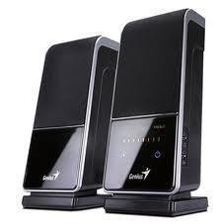
Speakers
This produces output in form of sound.

Slide 47
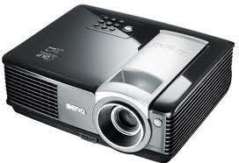
Projector
It enables an image to be displayed onto a flat surface. They are commonly used in meetings and presentations because they allow for a large image that everyone in a room can use.

Slide 48
Storage devices
Are devices used to save information and programs.
TYPES OF STORAGE DEVICES
Temporary(Primary) storage devices
Permanent (Secondary) Storage Devices

Slide 49
Temporary (primary) storage devices.
These are used for temporary storage of data that is currently being processed. It loses data when power is turned off (volatile)
Example: Random Access Memory (RAM)

Slide 50
Permanent (secondary) storage devices
These are used for permanent storage of information and programs, whether power supply is on/off (non-volatile).
There are two types of storage:
Internal storage e.g. Hard Disk Drive (HDD)
External storage/ removable storage.

Slide 51
External storage
Hard disk Drive (HDD): This stores all programs and files, as well as the operating system. In general, all data, information you have save in your computer are stored in HDD.
The capacity of the HDD is a measure of how much information it can store. There are HDD which have 10GB, 20GB, 30GB, 200GB, 320GB, 500GB, 1000GB etc.

Slide 52
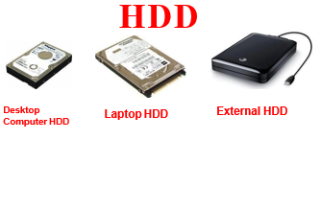

Slide 53
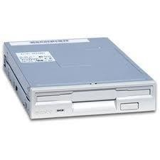
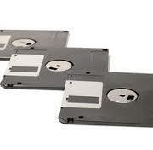
Floppy Disk Drive
Floppy disk drive (FDD): This magnetically reads and writes information onto floppy diskettes, which are in form of removable storage media.
The floppy diskette only holds 1.44MB of information although most of the PCs still have the floppy drive

Slide 54
Optical Disks
This is a removable disk on which data is written and read through the use of laser beam
These are mostly used in music industry
Examples of optical disks are:
CD-R (Compact Disk-Recordable).
CD-RW (Compact Disk Rewritable).
DVD-ROM (Digital Versatile Disk).

Slide 55
CD-ROM drive
It is a secondary storage device that reads information stored on a compact disc. It can hold about 700MB
Types of Compact Disks (CD)
Compact Disc Recordable (CD-R)
Compact Disc Rewritable (CD-RW)

Slide 56
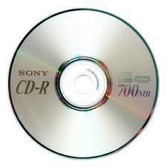
CD-R
There is no possibility of rewriting data

Slide 57
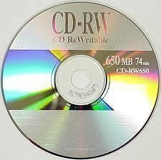
CD-RW
There is a possibility of rewriting data.

Slide 58
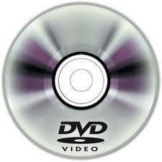
DVD ROM (Digital Versatile Disc Read Only Memory)
It looks like a CD but its storage capacity is significantly higher than CDs, DVDs can hold about 4.7GB of data up to 18GB.

Slide 59
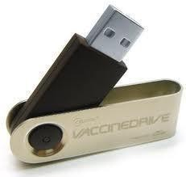
Flash Drive
It is a portable solid state memory device that plugs into the USB port on your computer. They may also be called key drive, pocket drive, thumb drive, pen drive.

Slide 60
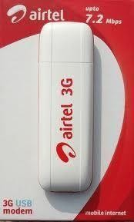
COMMUNICATION DEVICES
Communication devices used for the purpose of linking/connecting computers together .It includes Network cards, fibre optic cables, coaxial cables, twisted pair cables, modem, satellites, switches etc.
modem

